Slide 1
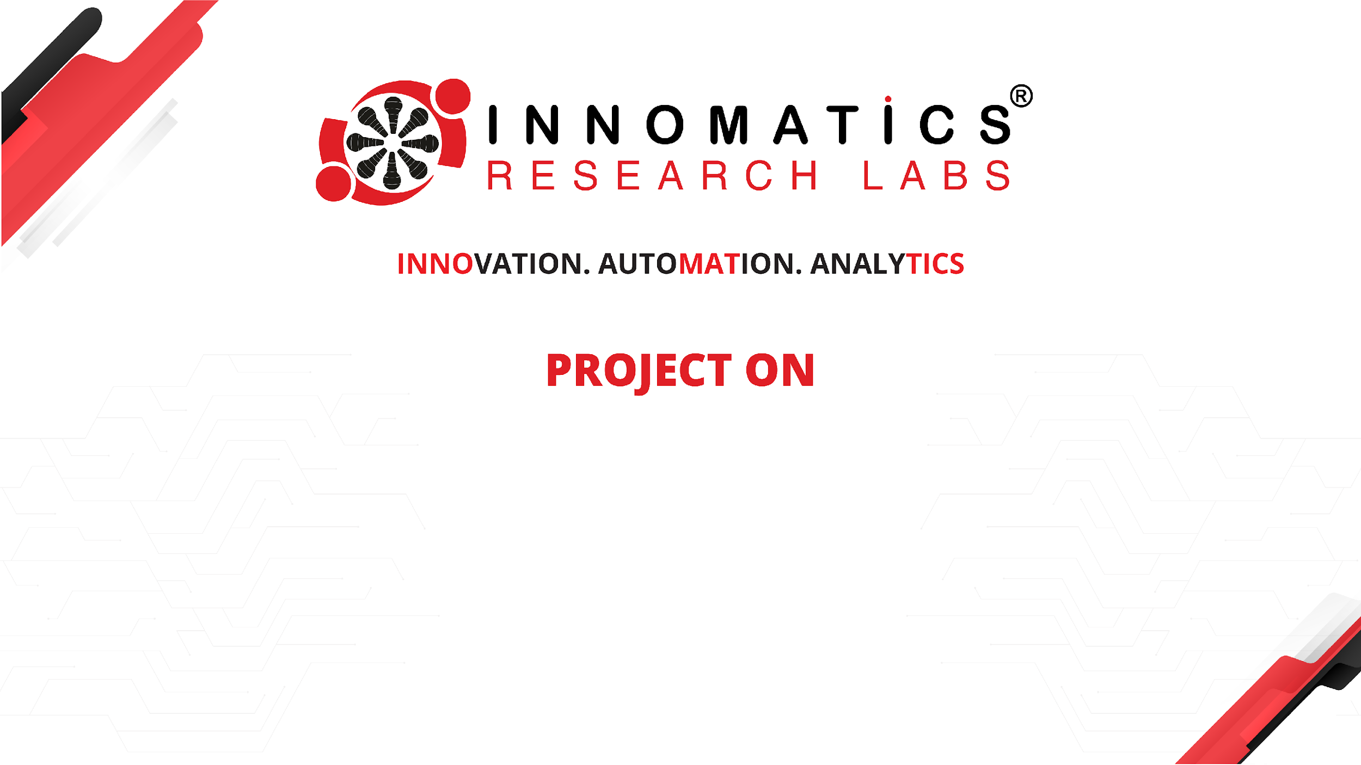
Analysis of AMCAT Data

Slide 2
About me
I am a B.Tech graduate with a passion for data science.
Throughout my academic journey, I've developed strong problem-solving skills and an analytical skills.
My interest in data science stems from its ability to extract meaningful insights from complex datasets, driving informed decision-making and innovation across various industries.
Despite lacking prior work experience, I am eager to immerse myself in the field and contribute to impactful projects.
I'm committed to continuous learning and staying updated with the latest advancements.
Connect with me on LinkedIn: https://www.linkedin.com/in/dasari-sai-srujan-goud-450798273 and explore my projects on GitHub: https://github.com/Dasarisaisrujangoud .

Slide 3
Objective of the Project
Introduction
Data Import
Data Cleaning Steps
Data Manipulation Steps
Univariate Analysis
Bivariate Analysis
Research Questions
Bonus
Conclusion

Slide 4
Introduction
In the exploratory data analysis (EDA) of the MBA placement dataset, I conducted various operations on Dataset such as univariate analysis to understand the distributions of numerical and categorical variables through histograms, boxplots, and countplots.
Additionally, bivariate analysis was performed to explore relationships between variables, including scatter plots to examine the relationship between salary and percentage in 10th grade, swarm plots to visualize the relationship between gender and specialization, and a stacked bar plot to analyze the distribution of placements based on gender.

Slide 5
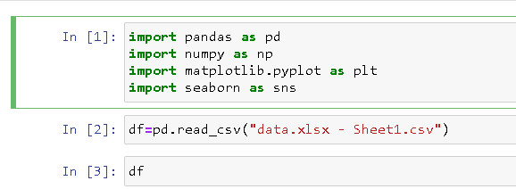
Data Import
Import library Numpy,Pandas,Seaborn,Matplotlib.
Import dataset

Slide 6
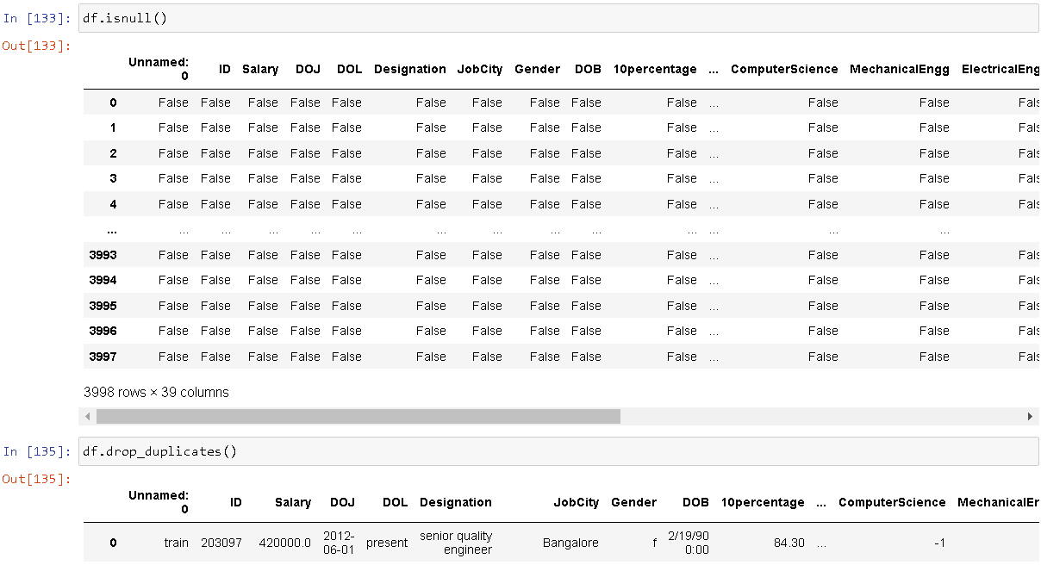
Data Cleaning Steps
Data cleaning is an essential step in the data analysis process that involves identifying and correcting errors, inconsistencies, and missing values in the dataset to improve its quality and reliability.

Slide 7
Data Manipulation Steps
Data manipulation involves transforming, reshaping, and aggregating data to extract meaningful insights and prepare it for analysis or visualization.
df["DOJ"]=pd.to_datetime(df["DOJ"])
Convert into object to datetime
max_salary_by_state = df.groupby('CollegeState')['Salary'].max()
Group the college state and salary
doj=df[(df["DOJ"]>="01/01/10") & (df["DOJ"]<="01/01/15") ]
Date of joining between 2010 t0 2015

Slide 8
Data Manipulation Steps
Bonus question
Filter the data based on desgination
avg_sal= df[df['Designation'].str.contains('Software Engineer', case=False)]
avg_sal1= df[df['Designation'].str.contains('Hardware Engineer', case=False)]
avg_sal2= df[df['Designation'].str.contains('Associate Engineer', case=False)]
avg_sal3= df[df['Designation'].str.contains('Programming Analyst', case=False)]

Slide 9
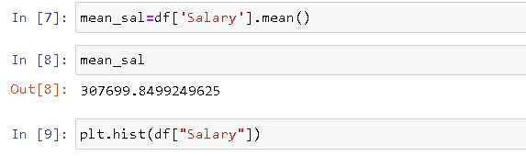
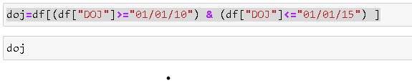
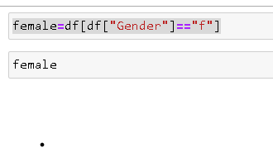
Univariate Analysis
ON average salary,Date of join between 2010 and 2015,average salary females

Slide 10
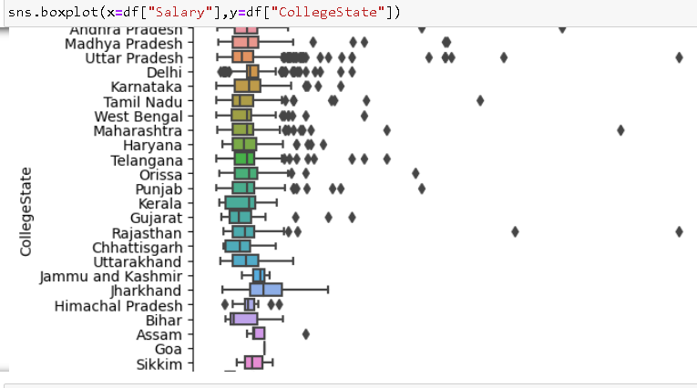
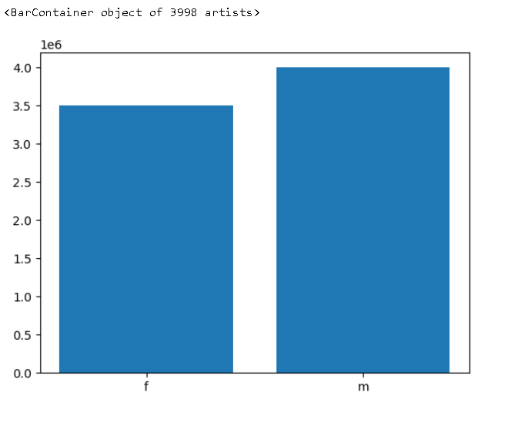
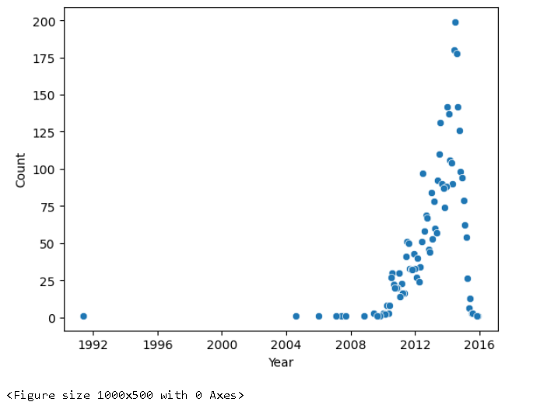
Bivariate Analysis

Slide 11
Research Questions
What is an average salary?
whose date of joining is between 2010 to 2015 has average, minimum,maximum ofsalary?
what is the Maximum salary of females?
find highest salary state?
who had highest salary male or female?
What type of designation has the highest salary?

Slide 12
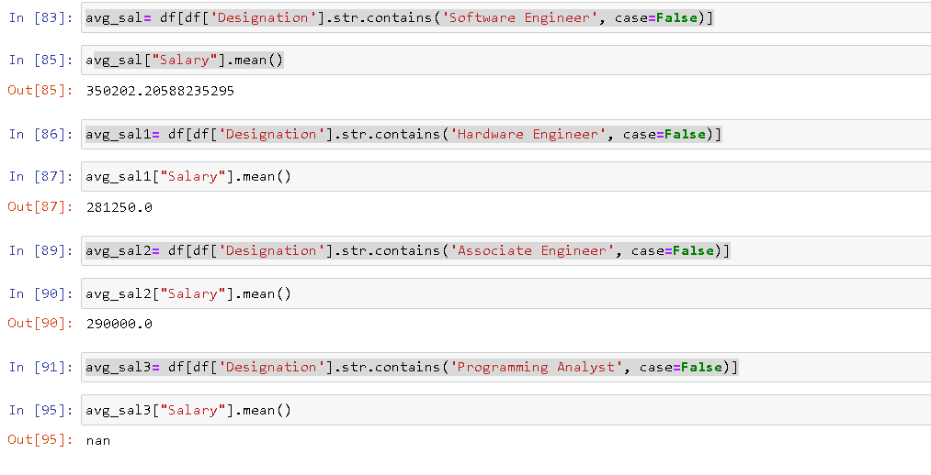
Bonus Question
Times of India article dated Jan 18, 2019 states that “After doing your Computer Science Engineering if you take up jobs as a Programming Analyst, Software Engineer, Hardware Engineer and Associate Engineer you can earn up to 2.5-3 lakhs as a fresh graduate.” Test this claim with the data given to you.

Slide 13
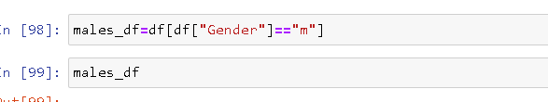
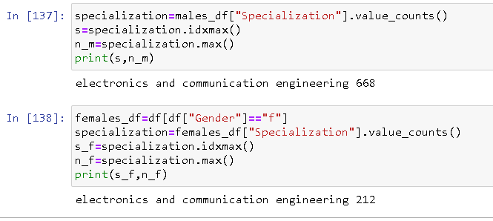
Bonus Question
2. Is there a relationship between gender and specialization? (i.e. Does the preference of Specialization depend on the Gender?)

Slide 14
Conclusion
Regarding my experience and challenges working on web scraping and data analysis projects, I found the process to be both rewarding and challenging.
Web scraping posed challenges such as handling dynamic web pages, dealing with anti-scraping measures, and ensuring data integrity and quality.
However, overcoming these challenges through the use of appropriate tools and techniques allowed me to gather valuable data for analysis.
Additionally, conducting data analysis provided opportunities to gain insights, identify patterns, and draw meaningful conclusions from the data.
Overall, the experience enhanced my skills in data collection, cleaning, analysis, and visualization, while also highlighting the importance of perseverance and problem-solving in overcoming challenges encountered during the project.

Slide 15

THANK YOU

